Slide 1
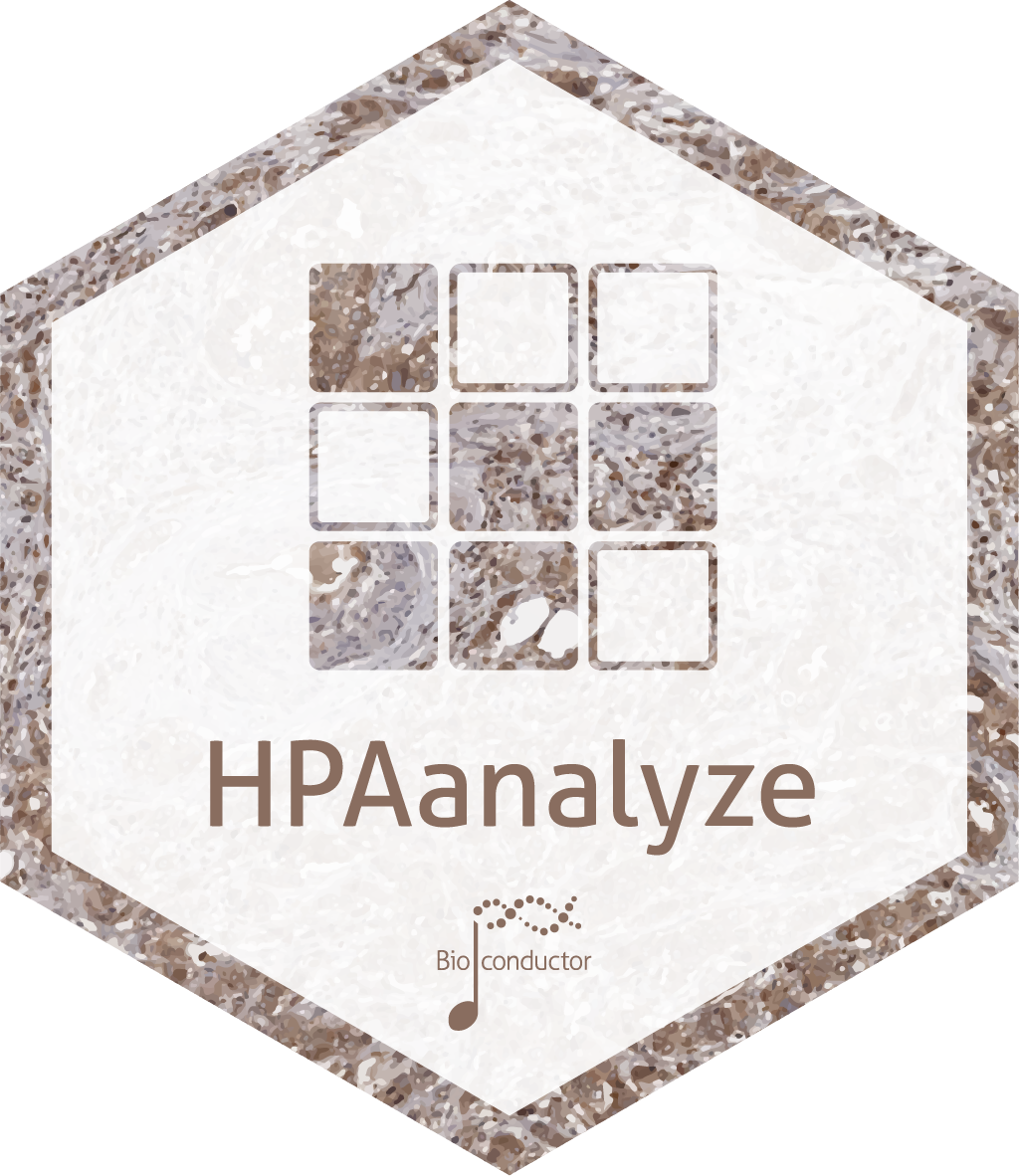

Writing a (very niche) R package for reproducible data analysis from a public dataset
Anh N. Tran
Postdoc at Northwestern U.
@anh_n_tran
trannhatanh89
SatRday Chicago, April 27, 2019

Slide 2
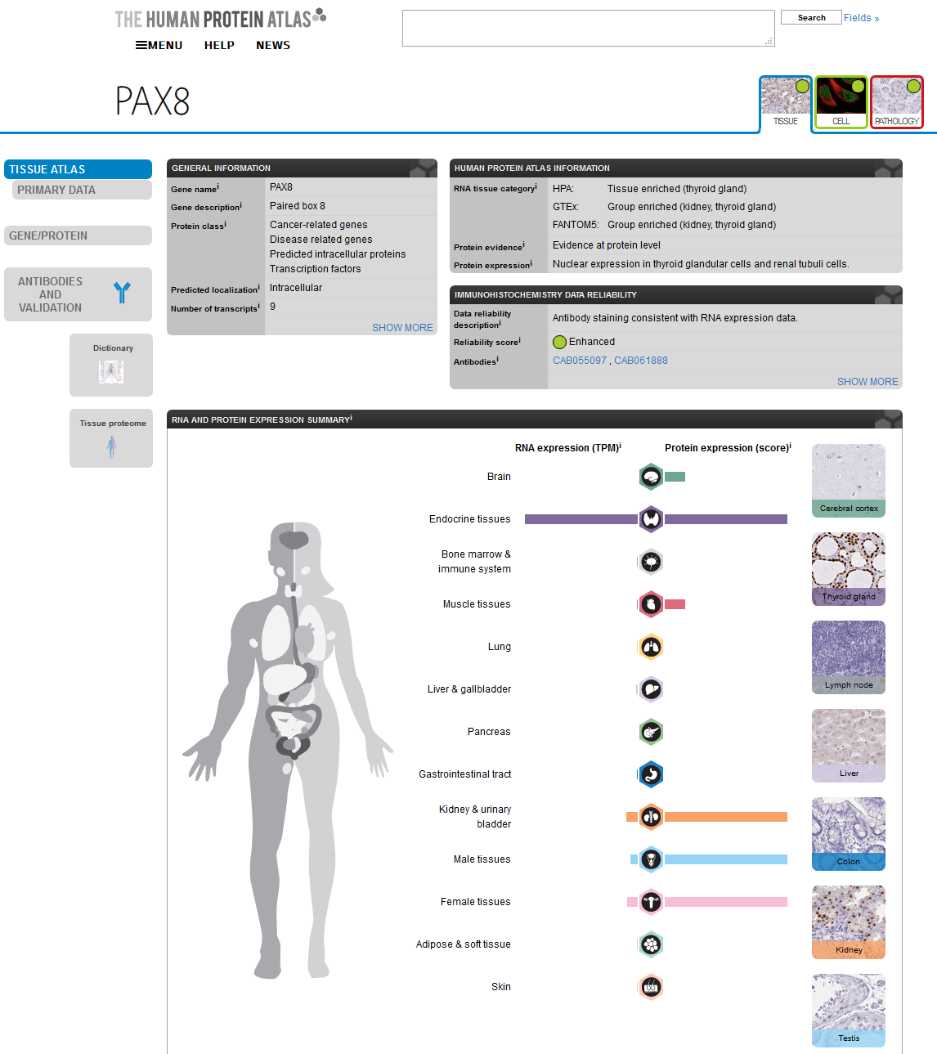
Full of info, but untidy
Graph are pretty
Hard to retrieve data for reproducibility
www.proteinatlas.org

Slide 3
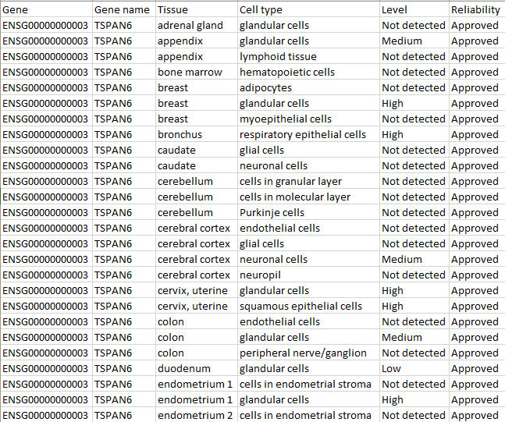




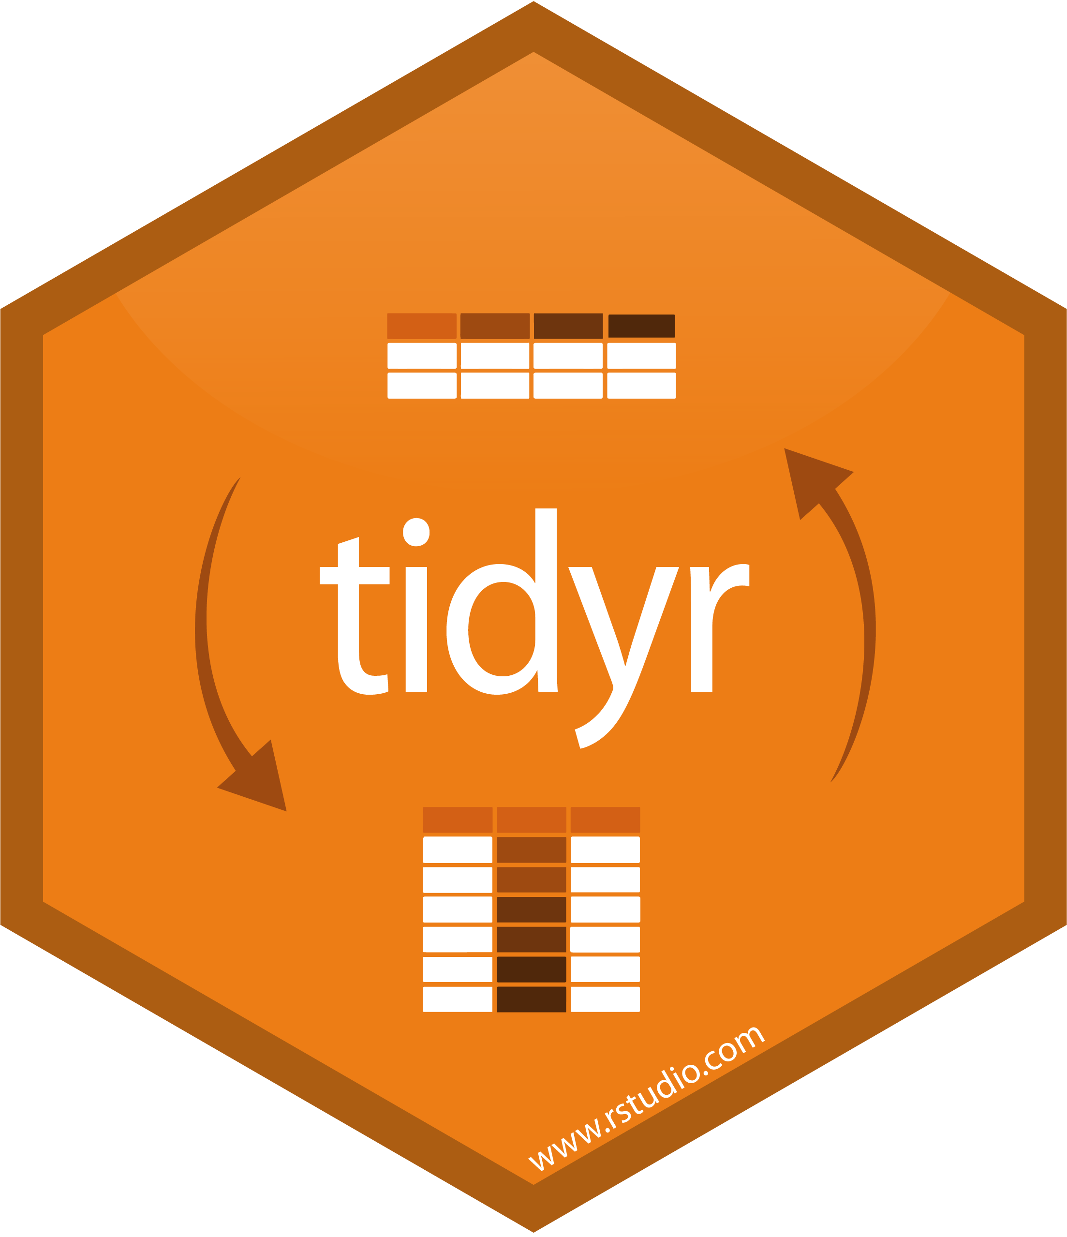
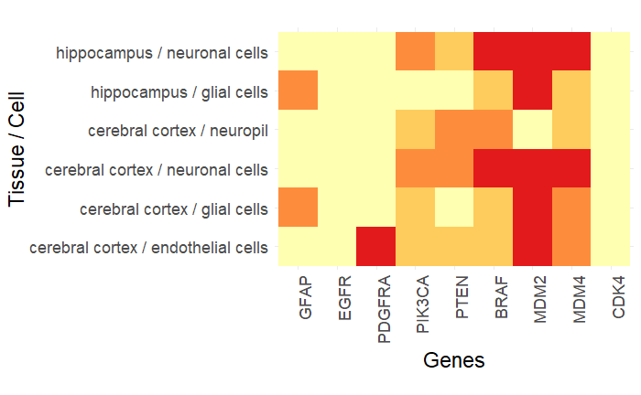
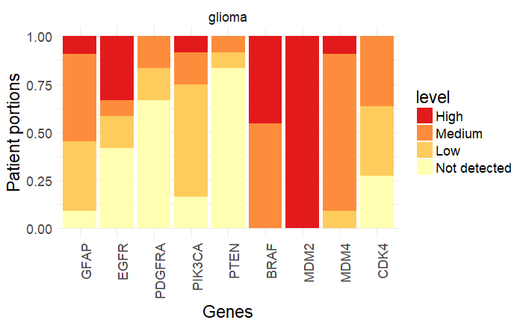
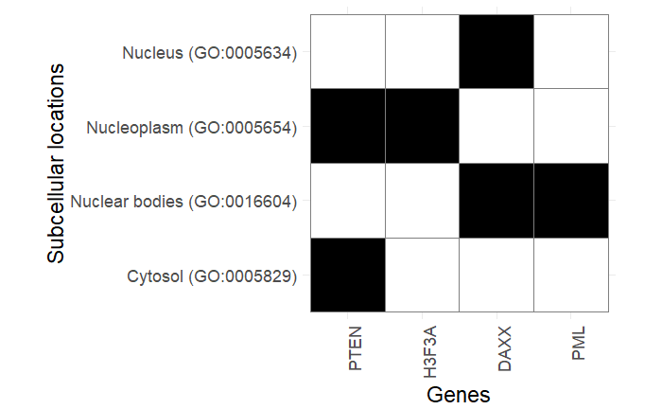
Summarized data provided as .tsv
openxlsx

Slide 4
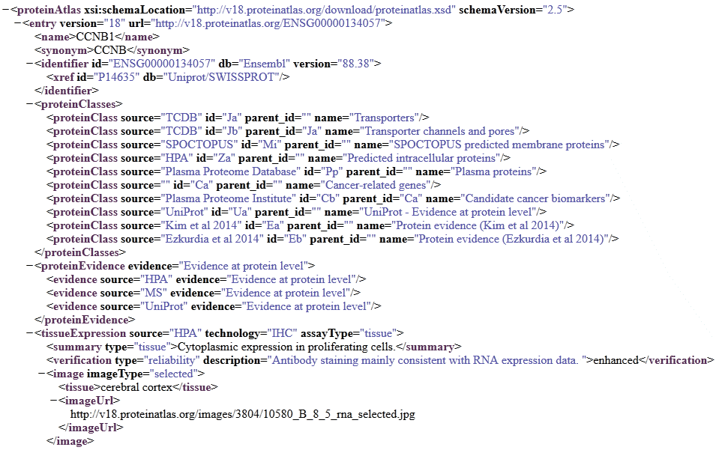
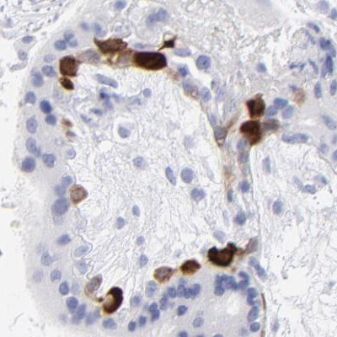
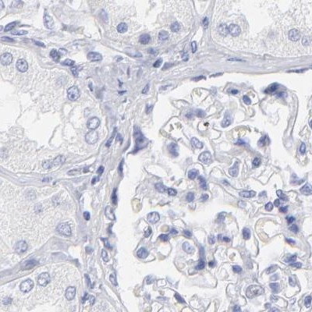
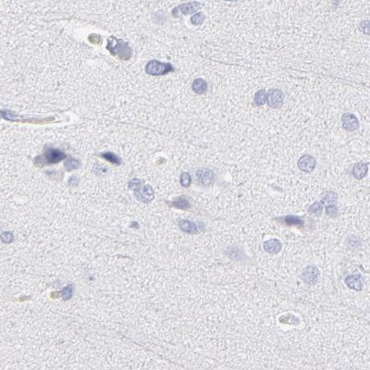
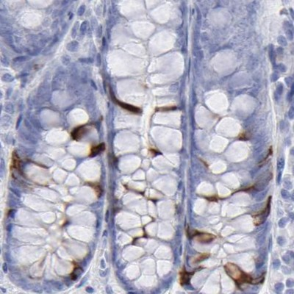
Full datasets provided as .xml(s)
xml2
#> # A tibble: 327 x 18
#> patientId age sex staining intensity quantity location imageUrl
#> <chr> <chr> <chr> <chr> <chr> <chr> <chr> <chr>
#> 1 1653 53 Male <NA> <NA> <NA> <NA> http://~
#> 2 1721 60 Fema~ <NA> <NA> <NA> <NA> http://~
#> 3 1725 57 Male <NA> <NA> <NA> <NA> http://~
#> 4 4 25 Male <NA> <NA> <NA> <NA> http://~
#> 5 512 34 Fema~ <NA> <NA> <NA> <NA> http://~
#> 6 2664 74 Fema~ <NA> <NA> <NA> <NA> http://~
#> 7 2665 88 Fema~ <NA> <NA> <NA> <NA> http://~
#> 8 1391 54 Fema~ <NA> <NA> <NA> <NA> http://~
#> 9 1447 45 Fema~ <NA> <NA> <NA> <NA> http://~
#> 10 1452 44 Fema~ <NA> <NA> <NA> <NA> http://~
#> # ... with 317 more rows, and 10 more variables: snomedCode1 <chr>,
#> # snomedCode2 <chr>, snomedCode3 <chr>, snomedCode4 <chr>,
#> # snomedCode5 <chr>, tissueDescription1 <chr>, tissueDescription2 <chr>,
#> # tissueDescription3 <chr>, tissueDescription4 <chr>,
#> # tissueDescription5 <chr>

Slide 5
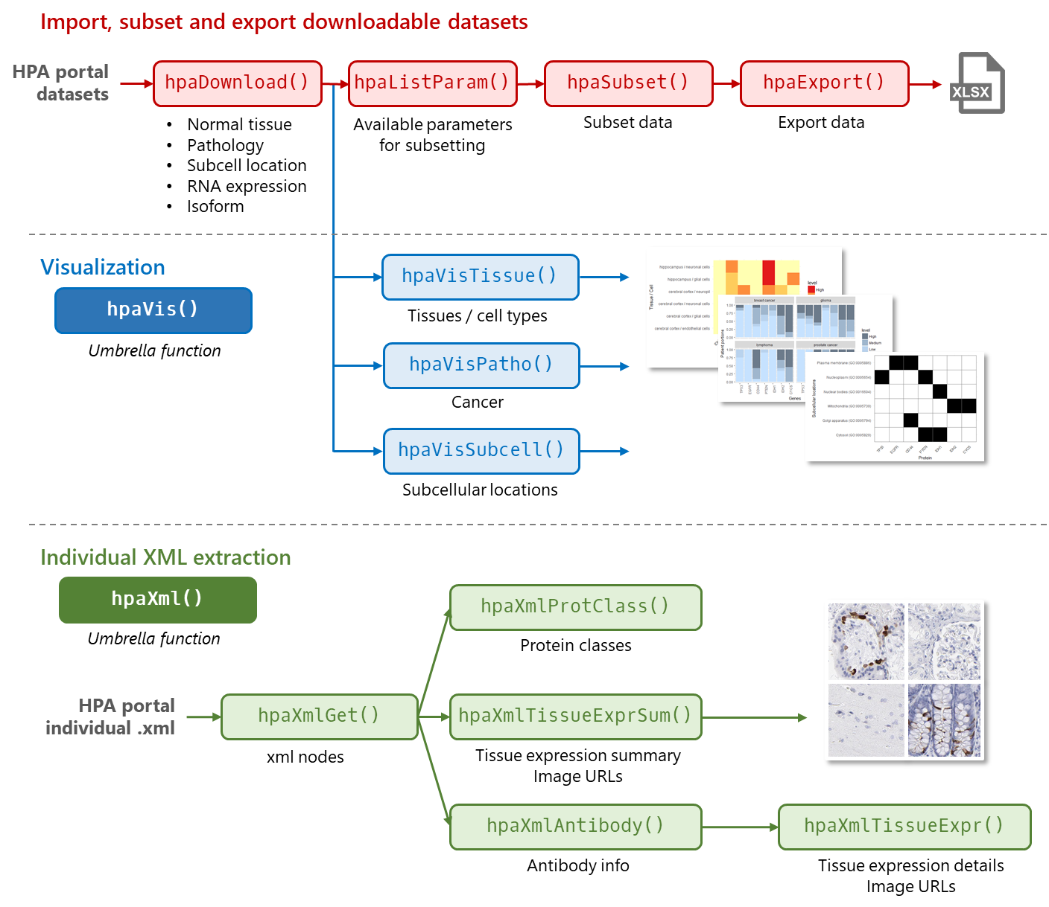

Slide 6
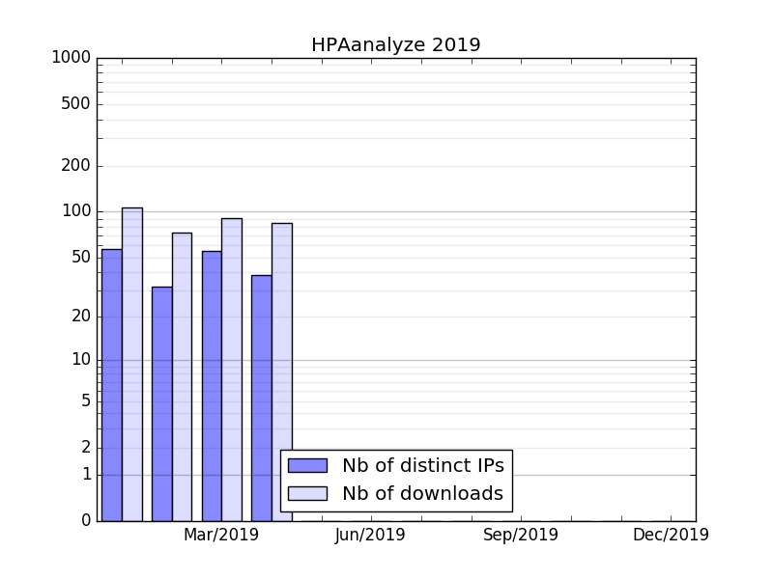
You’re welcome, my 50 users!
http://bioconductor.org/packages/stats/bioc/HPAanalyze/ (April 26, 2019)

Slide 7
It’s kinda lonely in the niche…
Issues may go unreported
Hard to get user feedbacks
and no community support
Advanced functionalities
may not worth it
Hex sticker never gets printed ☹

Slide 8
It’s kinda lonely in the niche…
Issues may go unreported
Submit to a repository for review
Continuous integration
Hard to get user feedbacks
and no community support
Local beta testers
Reach out via social media
Approachable vignettes/README
Advanced functionalities
may not worth it
Vignettes for advanced use cases
Hex sticker never gets printed ☹
☹

Slide 9





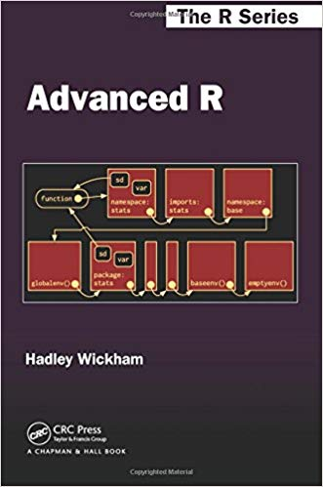


Acknowledgement
openxlsx
reshape2
xml2
Thank you!
cowplot
NOPE!!!

